Slide 1

长江汽车电子MES系统方案
群电同津厂
TPMS Deployment Plan
2021-05-28

Slide 2
系统部署调整(Phase II)
Host-1: (249)
CPU: 5117*2, Memory: 128G,
Network:万兆网卡*4,
Storage:2T 10K SAS*3, 500G SSD*2
Host-2: (248)
CPU: 5117*2, Memory: 128G,
Network:万兆网卡*4,
Storage:2T 10K SAS*3, 500G SSD*2
Host-3: (247)
CPU: 5117*2, Memory: 128G,
Network:万兆网卡*4,
Storage:2T 10K SAS*3, 500G SSD*4
VM1-1: IotServer-MP1(tpmsiot/231)
AMS Kanban/Services
VM2-1: IotMonitor-MP1(232)
Device Agents
VM3-1: IotMonitor-MAG1(242)
Device Agents
VM1-2: TPMS (tpms/233)
TPMS Portal
LDAP/mail-server/xlog
VM2-2: Mongodb(mag.tpms/234)
TPMS MAG
MongoDB4.2.6(PRIMARY)
VM3-2: IotServer-MAG1(mag.tpmsiot/241)
AMS Kanban/Services
VM1-3: TPMS-MP(mp.tpms/235)
TPMS MP
MongoDB4.2.6(SECONDARY)/Kettle
VM2-3: IotServer-MP2(243)
AMS Services(预留)
VM3-3: PG & InfluxDB (SSD x2)
（tpmsinflux/236)
InfluxDB/Grafana7/PostgreSQL
MongoDB4.2.6(SECONDARY Hidden)
VM1-4: esb1 (vip:239/237)
Hazelcast/
KeepAlived/RabbitMQ
VM2-4: esb2(vip:239/238)
Hazelcast/
KeepAlived/RabbitMQ
VM3-4: IotMonitor-MP2(244)
Device Agents(预留)
VM1-5(Win10) : ASS1
VM2-5(Win10): ASS2
VM3-5(Win10): MGMT
新增域名: mp.tpms/235, mag.tpms/234,mag.tpmsiot/241
新增4个IP: 241~244
迁移236/TPMSINFLUX VM到独立SSD的第三台主机
迁移235/PostgreSQL到236/TPMSINFLUX VM
拆分MP/MAG TPMS 系统&DB

Slide 3
TPMS 软件环境 – Phase I
Machine Name | OA IP | Internal IP | Component | Hardware
IotServer1 (TPMSIOT.sz.chiconypower.com.cn) | 172.25.57.231 | 10.4.100.231 | TV/DM/DataRecord/TSDBService/Alarm/DeviceStatus/AppService/OEE/BusAnnounce/SPC/Telegraf | cpu:16cores dimm:10G OS HDD:50G ssd
IotMonitor1 | 172.25.57.232 | 10.4.100.232 | Agents
DeviceSpare (TPMS.sz.chiconypower.com.cn) | 172.25.57.233 | 10.4.100.233 | TPM Dbus/Device/Spare/Alarm/guard/safe/Nginx/Telegraf
Mongodb | 172.25.57.234 | 10.4.100.234 | MongoDB4.2.6/Telegraf
PG | 172.25.57.235 | 10.4.100.235 | MongoDB4.2.6/PostgreSQL/Kettle/Drkon/etcd/Telegraf
Influxdb ( TPMSINFLUX.sz.chiconypower.com.cn) | 172.25.57.236 | 10.4.100.236 | MongoDB4.2.6/InfluxDB/Grafana/Telegraf
esb1 | 172.25.57.237 vip:172.25.57.239 | 10.4.100.237 vip:10.4.100.239 | Hazelcast/jre1.8/KeepAlived/RabbitMQ/Telegraf
esb2 | 172.25.57.238 vip:172.25.57.239 | 10.4.100.238 vip:10.4.100.239 | Hazelcast/jre1.8/KeepAlived/RabbitMQ/Telegraf

Slide 4
系统部署配置(Phase I)
Host-1:
Host-2:
硬体
1.CPU: 5117*2
2.Memory：128G
3.Network：万兆网卡*4
4.Storage：2T 10K SAS*3, 300G SSD*2
软体
Microsoft Hyper-V Server 2019(Client:Win10 Hyper-V Manager)
Ubuntu 18.04
MongoDB4.2.3、Postgres、InfluxDB
NodeJS 8.9.4/Python2.7.17
Nginx 1.10.3
RabbitMQ/MQTT
Grafana/Telegraf/Kettle
TPMS
IOT Devices
2 PLC网关 Per Line
PLC转换模块
VM1-1: IotServer1
OS: Ubuntu 18.05/Telegraf 1.10.4/Grafana/
Python:2.7.17/NodeJS v8.11.1
TV(AMS Kanban)/
DM(AMS Data Manager)
/DataRecord/TSDBService
VM2-1: IotMonitor1
OS: Ubuntu 18.05/Telegraf 1.10.4
Python:2.7.17
Alarm/DeviceStatus/
AppService/
OEE/BusAnnounce/SPC
VM1-2: DeviceSpare
OS: Ubuntu 18.05/Telegraf 1.10.4
Nginx 1.14.0/NodeJS 8.9.4
GraphicsMagick 1.3.23
TPM Dbus/Device/Spare/Alarm/guard/safe
VM2-2: Mongodb
OS: Ubuntu 18.05/Telegraf 1.10.4
MongoDB4.2.6(PRIMARY)
VM1-3: PG
OS: Ubuntu 18.05/Telegraf 1.10.4
MongoDB4.2.6(SECONDARY)
PostgreSQL/Kettle
VM2-3: InfluxDB
OS: Ubuntu 18.05/Telegraf 1.10.4
MongoDB4.2.6(SECONDARY Hidden)
InfluxDB
VM1-4: esb1
OS: Ubuntu 18.05/Telegraf 1.10.4
Hazelcast/
KeepAlived/RabbitMQ
VM2-4: esb2
OS: Ubuntu 18.05/Telegraf 1.10.4
Hazelcast/
KeepAlived/RabbitMQ

Slide 5
Hyper-V Server 2019管理
参考URL
https://blog.csdn.net/weixin_30293135/article/details/101113957
https://blog.csdn.net/pkgfs/article/details/107090378
服务端操作 （Hyper-V Server 2019）
1、服务器开启后，配置计算机名、配置远程管控功能开启、远程桌面开启、ip地址固定
2、使用powershell命令，开启credssp
C:\Users\Administrator>powershell
PS C:\Users\Administrator> Enable-PSRemoting PS C:\Users\Administrator> Enable-WSManCredSSP -role server
3、关闭防火墙：
PS C:\Users\Administrator> netsh advfirewall set currentprofile state off
客户端操作 （Win10）
1、启用Hyper-V管理工具
2、修改hosts文件：如192.168.100.100 hyper-v-server
3、客户端工作组不能为“公用”
Win-设置-网络和Internet-状态-更改连接属性，公用改为“专用”
4、修改组策略
gpedit.msc----本地计算机策略----管理工具----系统----凭证分配：允许分配新的凭证用于仅NTLM服务器身份验证
启用并添加一行值：wsman/HYPER-V-SERVER
5、powershell执行命令：
开启winrm：winrm quickconfig
winrm安全配置：Set-Item WSMan:\localhost\Client\TrustedHosts -Value "HYPER-V-SERVER"
winrm身份验证配置：Enable-WSManCredSSP -Role client -DelegateComputer "HYPER-V-SERVER"

Slide 6
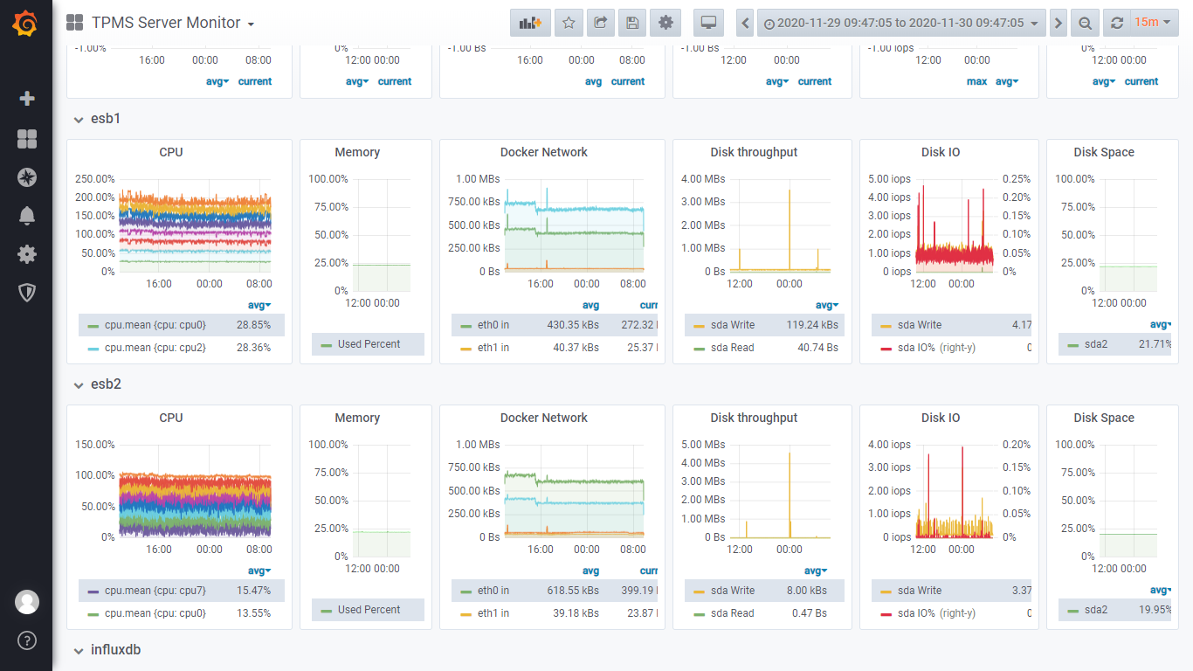
TPMS Server Monitor
Telegraf上报资源数据
Grafana Kanban
http://172.25.57.236:3000/d/7asd4fa567sd4/tpms-server-monitor

Slide 7
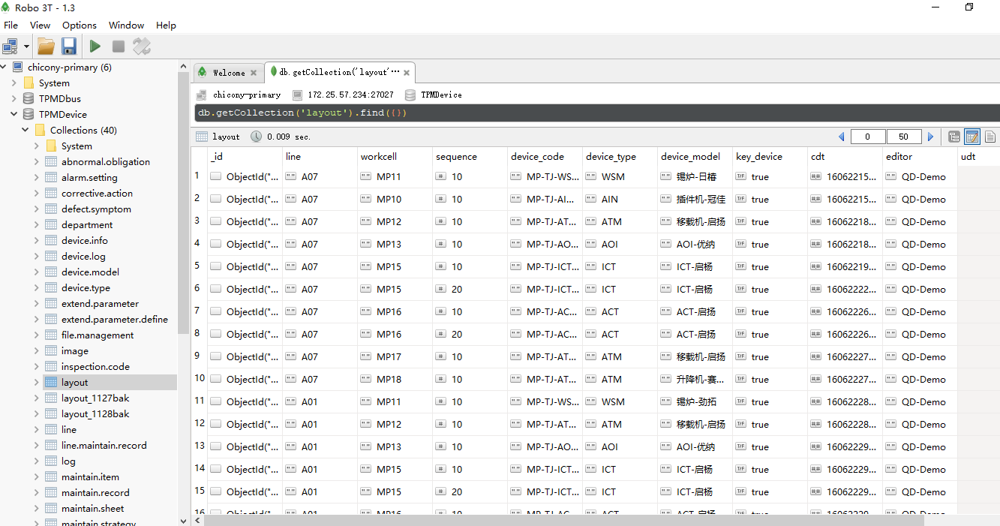
Database Management
MongoDB 4.2.6, Robo 3T 1.3.1管控

Slide 8
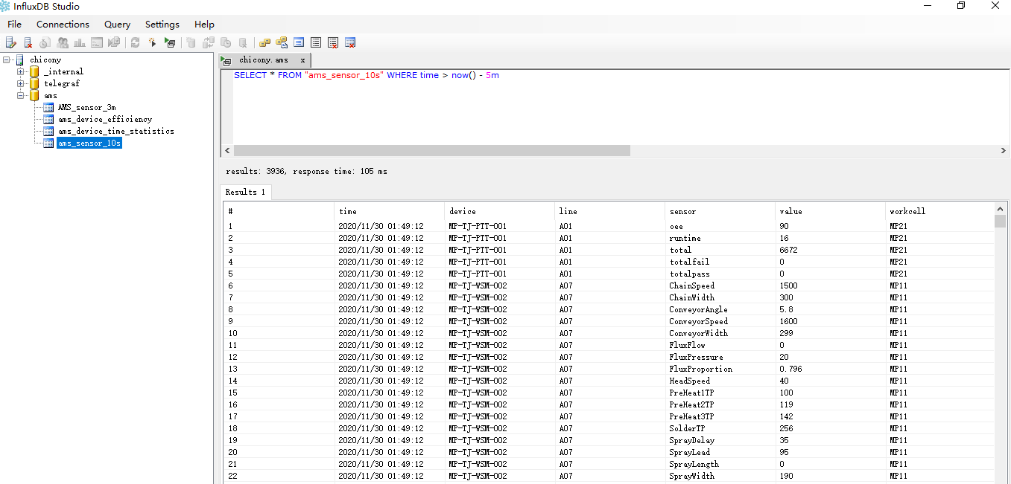
Database Management
InfluxDB 1.7.9, InfluxDBStudio-0.1.0管控

Slide 9
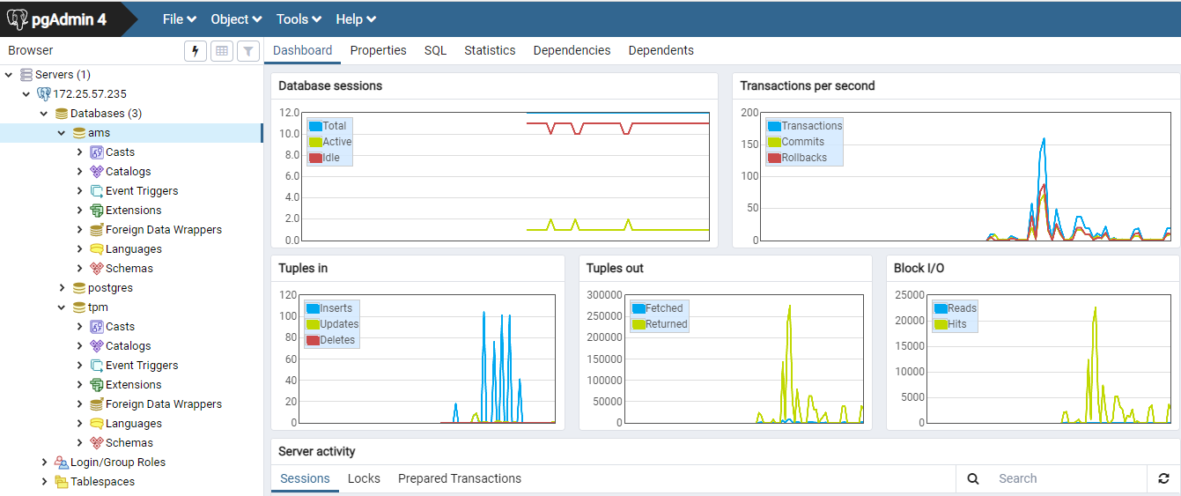
Database Management
Postgres 11.8, PGAdmin4.3管控

Slide 10


